Slide 1
2. Software Development Process
The specifics of what these people do, how they interact, and how they make decisions are all part of the software development process.
School of Software Engineering of South China University of Technology LiuGuixi

Slide 2
2. The Software Development Process
What major components go into a software product
What different people and skills contribute to a software product
How software progresses from an idea to a final product
School of Software Engineering of South China University of Technology LiuGuixi

Slide 3
Product Components
What Effort Goes Into a Software Product?
What Parts Make Up a Software Product?
School of Software Engineering of South China University of Technology LiuGuixi

Slide 4
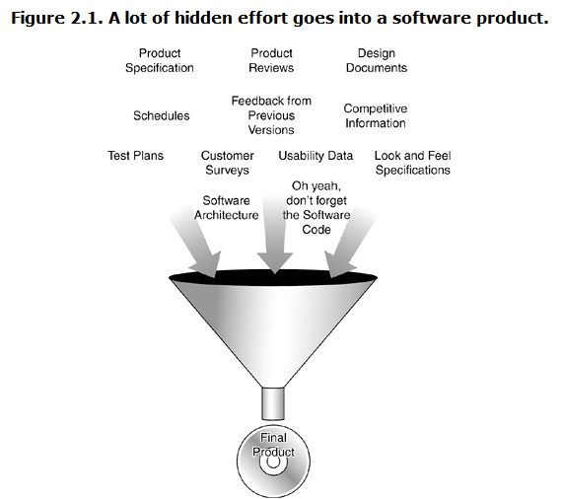
What Effort Goes Into a Software Product?
School of Software Engineering of South China University of Technology LiuGuixi

Slide 5
●Customer Requirements
■To properly fill that need, the product development team must find out what the customer wants.
■ Some teams simply guess
■ Most collect detailed information in the form of surveys, feedback from previous versions of the software,
----competitive product information,
----magazine reviews,
----focus groups,
-----and numerous other methods, some formal, some not.
School of Software Engineering of South China University of Technology LiuGuixi

Slide 6
●Customer Requirements
■All this information is then studied, condensed, and interpreted
■ To decide exactly what features the software product should have.
School of Software Engineering of South China University of Technology LiuGuixi

Slide 7
● Specifications
■ The result of the customer requirements studies is really just raw data.
■ It doesn't describe the proposed product, it just confirms whether it should (or shouldn't) be created and what features the customers want.
■ The specifications take all this information plus any unstated but mandatory requirements and truly define what the product will be, what it will do, and how it will look.
■ The format of specifications varies greatly.
School of Software Engineering of South China University of Technology LiuGuixi

Slide 8
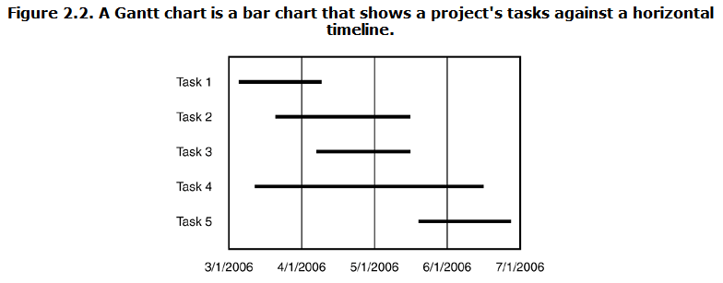
● scheduling
The goals of scheduling are to know which work has been completed, how much work is still left to do, and when it will all be finished.
School of Software Engineering of South China University of Technology LiuGuixi

Slide 9
Software Design Documents
● Architecture
● Data Flow Diagram
● State Transition Diagram
● Flowchart
● Commented Code
School of Software Engineering of South China University of Technology LiuGuixi

Slide 10
Test Documents
● test plan
● Test cases
● Bug reports
● Test tools and automation
● Metrics, statistics, and summaries
School of Software Engineering of South China University of Technology LiuGuixi

Slide 11
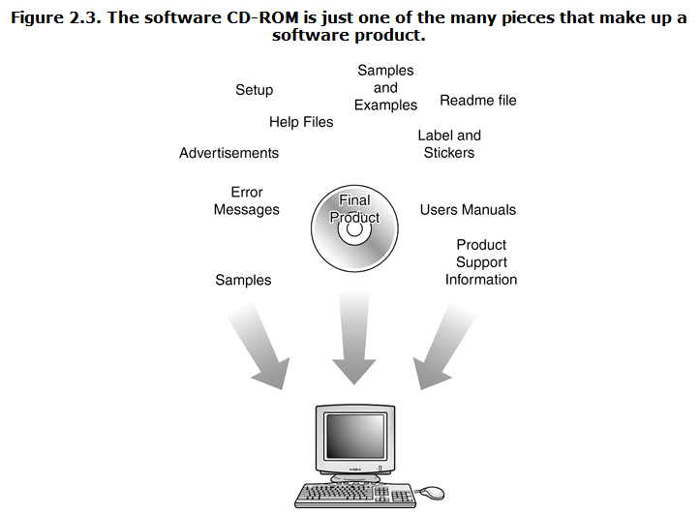
What Parts Make Up a Software Product?
School of Software Engineering of South China University of Technology LiuGuixi

Slide 12
What Parts Make Up a Software Product?
● It's also important to realize that when the product is ready to be boxed up and shipped out the door, it's not just the code that gets delivered.
● Numerous supporting parts go along with it.
● Since all these parts are seen or used by the customer, they need to be tested too.
School of Software Engineering of South China University of Technology LiuGuixi

Slide 13
Help files | User's manual
Samples and examples | Labels and stickers
Product support info | Icons and art
Error messages | Ads and marketing material
Setup and installation | Readme file
School of Software Engineering of South China University of Technology LiuGuixi

Slide 14
DON'T FORGET TO TEST ERROR MESSAGES
Error: Keyboard not found. Press F1 to continue.
Can't instantiate the video thing. Windows has found an unknown device and is installing a driver for it.
A Fatal Exception 006 has occurred at 0000:0000007.
School of Software Engineering of South China University of Technology LiuGuixi

Slide 15
Software Project Staff
Project managers, program managers, or producers
Architects or system engineers
Programmers, developers, or coders
Testers or QA (Quality Assurance) Staff
Technical writers, user assistance, user education, manual writers, or illustrators
Configuration management or builder
School of Software Engineering of South China University of Technology LiuGuixi

Slide 16
Software Development Lifecycle Models
Big-Bang
Code-and-Fix
Waterfall
Spiral
School of Software Engineering of South China University of Technology LiuGuixi

Slide 17
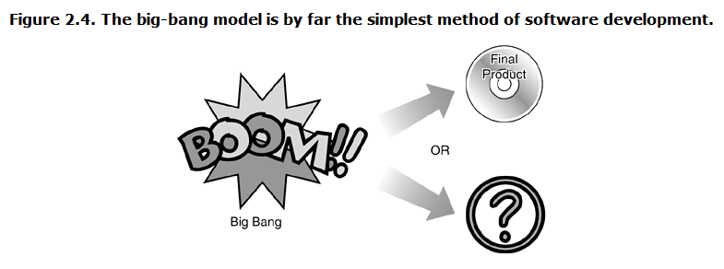
Software Development Lifecycle Models
Big-Bang
School of Software Engineering of South China University of Technology LiuGuixi

Slide 18
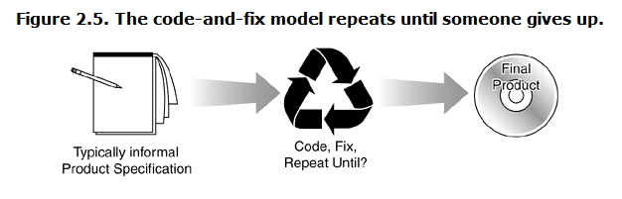
Software Development Lifecycle Models
Code-and-Fix
School of Software Engineering of South China University of Technology LiuGuixi

Slide 19
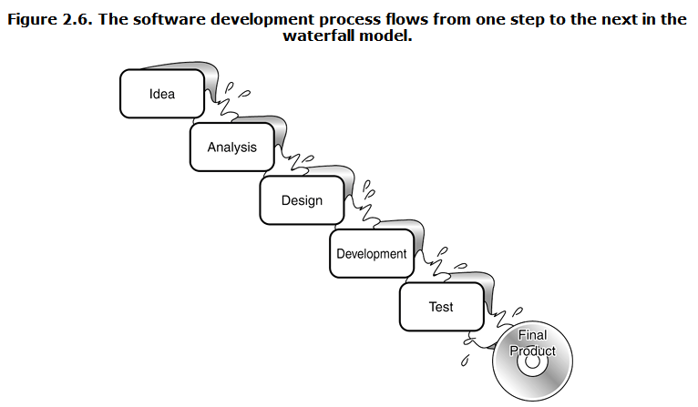
Software Development Lifecycle Models
Waterfall
School of Software Engineering of South China University of Technology LiuGuixi

Slide 20
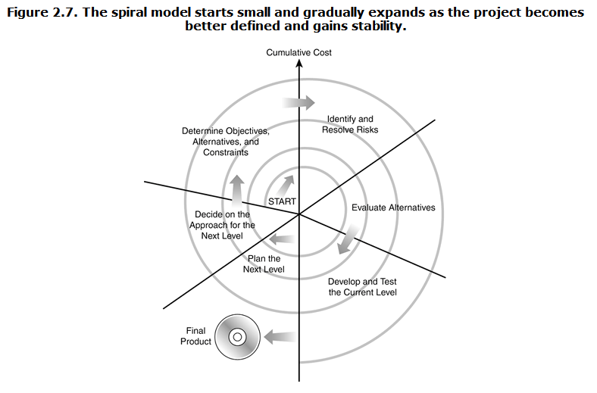
Software Development Lifecycle Models
Spiral
School of Software Engineering of South China University of Technology LiuGuixi

Slide 21
AGILE SOFTWARE DEVELOPMENT
Test-Driven Development，TDD
School of Software Engineering of South China University of Technology LiuGuixi

Slide 22
What is test-driven？
Test-driven is a form of development:
1. Write test code first
2. Do not write any production code unless tests exist
3. Does the test determine what code needs to be written
4. Require maintenance of a comprehensive test set
School of Software Engineering of South China University of Technology LiuGuixi

Slide 23
The basic process of test-driven development
Define application requirements
Familiarize yourself with the functional areas of the application and determine the individual functional items or functional requirements to be used
Create a test list of validation requirements
Define interfaces and classes for functions or requirements
Write test code
Run the test
Generate production code from the tests
Rerun the tests and modify the production code based on the tests until all the tests pass
Trim code
Repeat the above steps
School of Software Engineering of South China University of Technology LiuGuixi

Slide 24
Software Testing Model
School of Software Engineering of South China University of Technology LiuGuixi

Slide 25
“V ”模型
"V" Model
V Model is an enhanced version of the classic waterfall model whereby each level of the development life-cycle is verified before moving on to the next level.
With this model, software testing explicitly starts at the very beginning, i.e. as soon as the requirements are written.
School of Software Engineering of South China University of Technology LiuGuixi

Slide 26
“V ”模型
"V" Model– Advantages
in V Model, Each phase has specific deliverables.
Higher chance of success over the waterfall model due to the development of test plans early on during the life cycle.
Time concern in comparison with the waterfall model is low or even we can say 50% less.
Works well for small projects where requirements are easily understood.
Utility of the resources is high.
School of Software Engineering of South China University of Technology LiuGuixi

Slide 27
“V ”模型
"V" Model– Disadvantages
Very rigid, like the waterfall model.
Little flexibility and adjusting scope is difficult and expensive.
Software is developed during the implementation phase, so no early prototypes of the software are produced.
V Model doesn’t provide a clear path for problems found during testing phases.
School of Software Engineering of South China University of Technology LiuGuixi

Slide 28
"W" Model
Testing accompanies the entire software development cycle
Test not only the program, but also the requirements, design, and functionality
According to the requirements of the W model, once the documentation is provided, it is necessary to determine the test conditions and write test cases in time
School of Software Engineering of South China University of Technology LiuGuixi

Slide 29
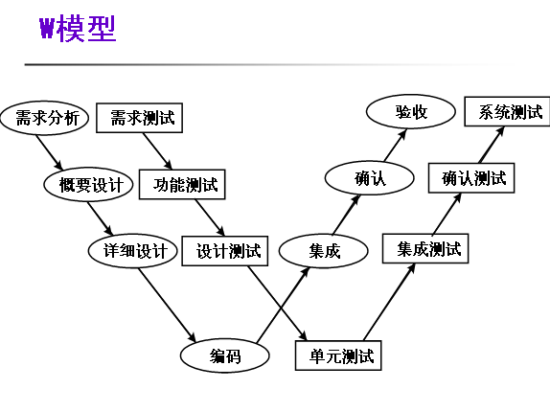
School of Software Engineering of South China University of Technology LiuGuixi

Slide 30
H model
软件测试不仅仅指测试的执行，还包括很多其他的活动。
软件测试是一个独立的流程，贯穿产品整个生命周期，与其他流程并发的进行。
软件测试要尽早准备，尽早执行。
软件测试是根据被测物的不同而分层进行的。不同层次的测试活动可以按照某个次序先后进行的，但也可能是反复的。
School of Software Engineering of South China University of Technology LiuGuixi

Slide 31
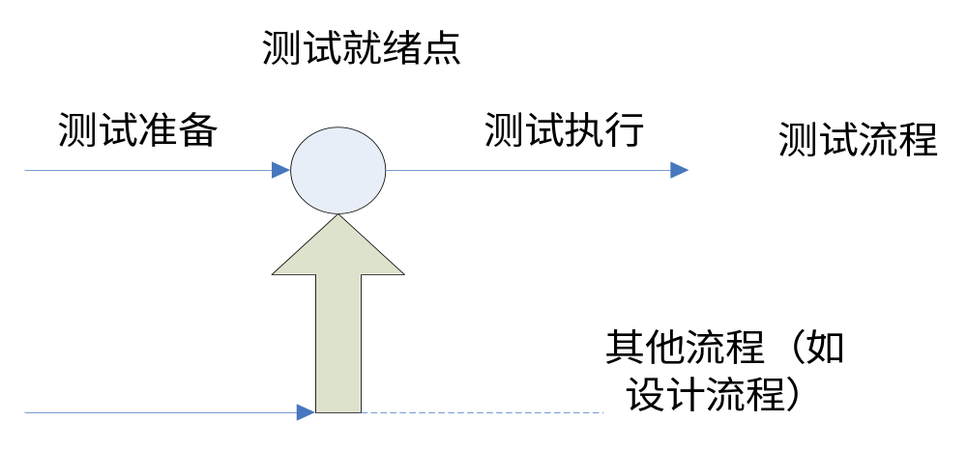
H Model
School of Software Engineering of South China University of Technology LiuGuixi

Slide 32
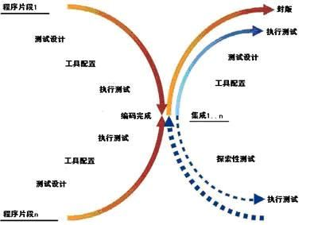
X Model
School of Software Engineering of South China University of Technology LiuGuixi

Slide 33
X Model
X 测试模型的左边描述的是针对单独程序片段所进行的相互分离的编码和测试，此后将进行频繁的交接，通过集成最终合成为可执行的程序(右上半部分)，这些可执行程序还需要进行测试。
已通过集成测试的成品可以进行封版并提交
给用户，也可以作为更大规模和范围内集成的一部分。
X 模型还定位了探索性测试(右下方)。
School of Software Engineering of South China University of Technology LiuGuixi

